Slide 1
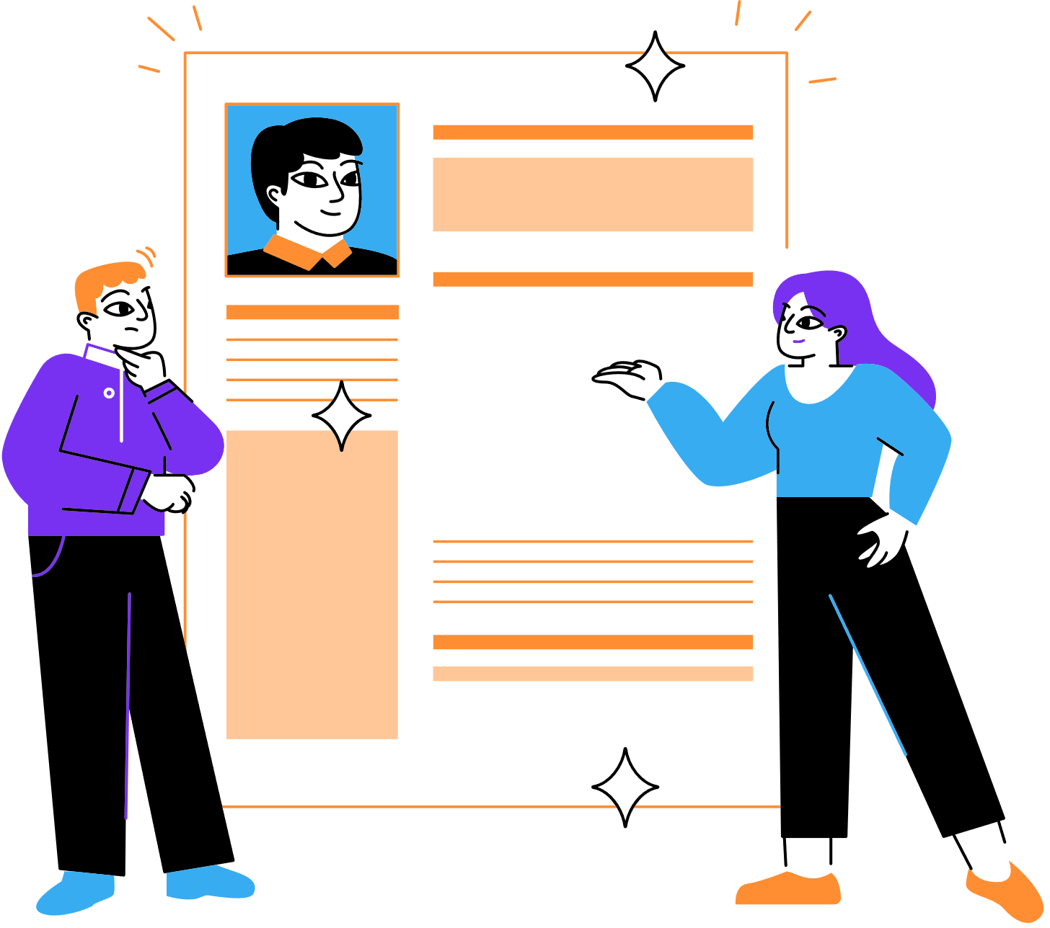
Curriculum
Vitae
Seven INC // HR
Sophia Bruckner
13 Juni 2023

Slide 2
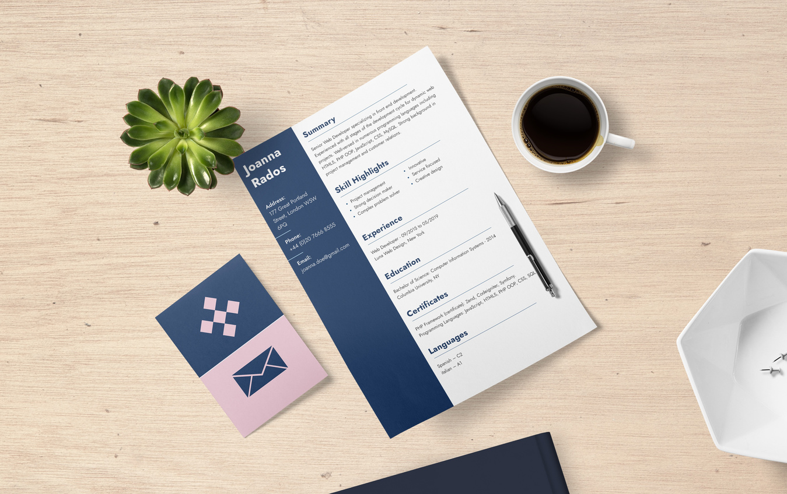
Introduction
CV is a document who summarizes your skills, education and work experience
First thing employees see from you
A good CV should be clear and tailored to the position you are applying for

Slide 3
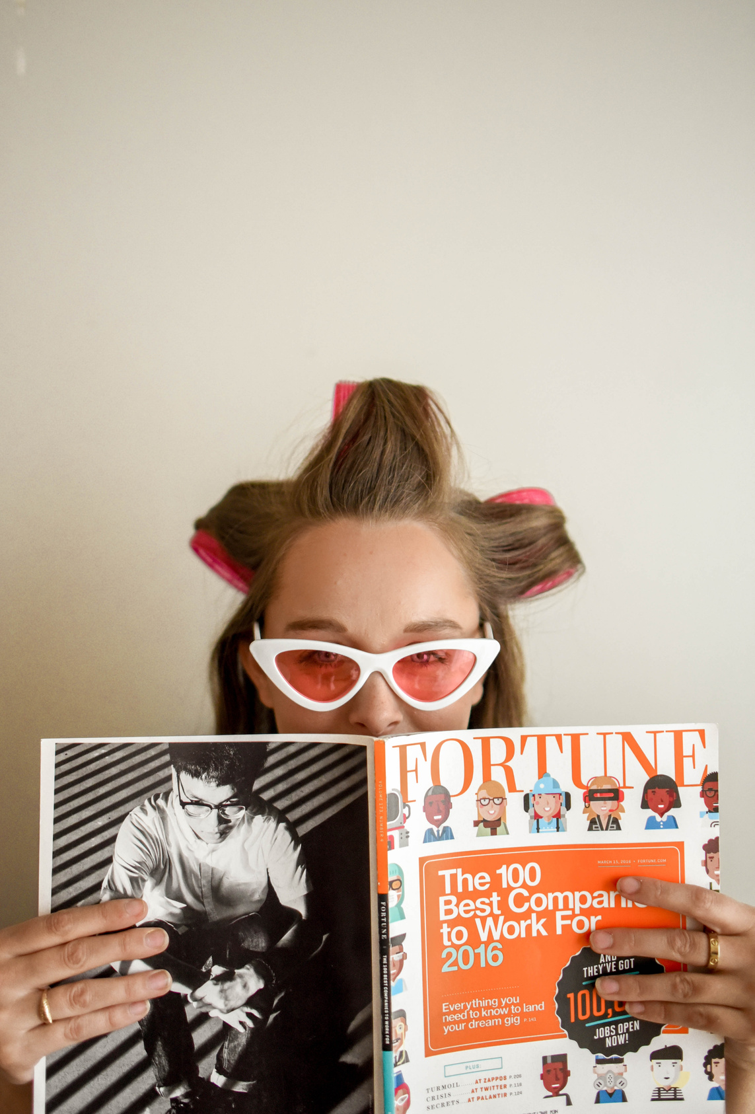
Name, Address,
Phone number (+62),
E-Mail
no need:
nationality (depends on country)
date of birth
status
religion
blood type
family member
strength and weaknesses
Personal Information

Slide 4


Education
academic qualifications
degrees
diplomas
certificates
institutions
awards
activities
demonstrate your skills and interests beyond the classroom

Slide 5
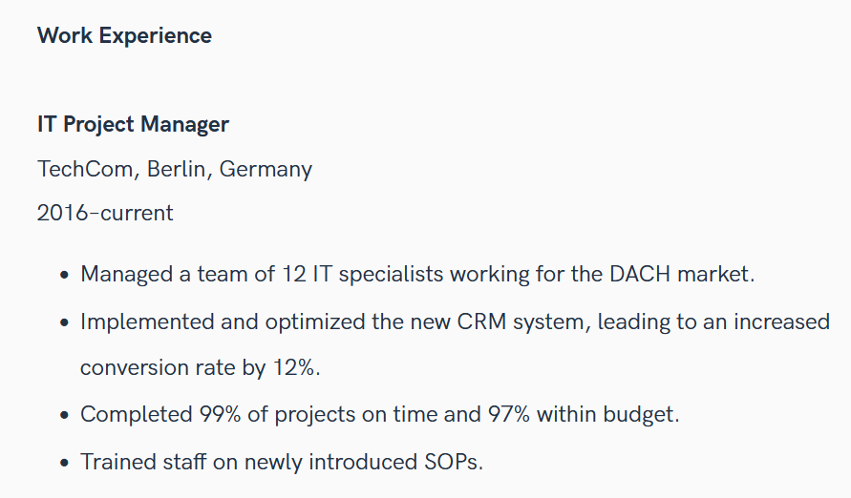
previous employment history
starting with the most recent
job title
company name
dates
brief description of responsibilities
min. 3 points
Work
Experience

Slide 6
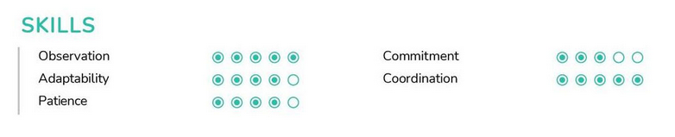
provide specific examples of how you have demonstrated these skills in the past
put a certificate of your skills at the end of the application
Skills
relevant skills or abilities
f.e.
technical skills (software)
soft skills (communication)
example:
Stressmanagement- taking time out, prioritizing tasks, etc.
technical skills (graphic design)

Slide 7

Formatting & Presentation
using a easy and clear font (Arial, TNR..), not too colorful
use A4 paper
organizing information into sections
consistent formatting
additional elements:
professional profile or summary
references
cover letter

Slide 8

Tips
include social media accounts (Instagram, Linked in, Facebook..)
add a formal close up foto (no selfie), wear formal clothes, not colorful (white...)
red or blue background (in Indonesia) in other countries doesn't matter.

Slide 9

ATS
What is ATS? (Applicant Tracking System)
It is a software application that streamlines the recruitment process by automating various tasks
essential tool for HR departments
reduce the time and effort required to manage the recruitment process
the system can recognize and scan each applicant's CV, both scholarships and jobs

Slide 10
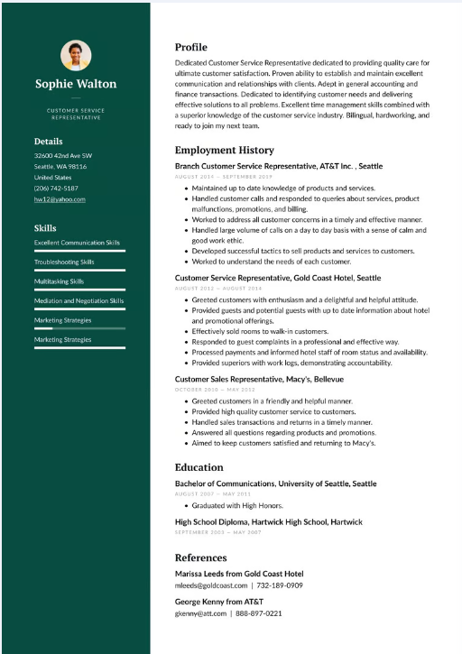
Tips
make your CV in English, if you can
no more than two sheets
standard font type (Arial, TNR), size min. 11
use keywords (can be different in every country/ company)
avoid spelling mistakes
avoid special characters (-->)
simply colours like black and white
avoid using graphics
pdf or docx format

Slide 11
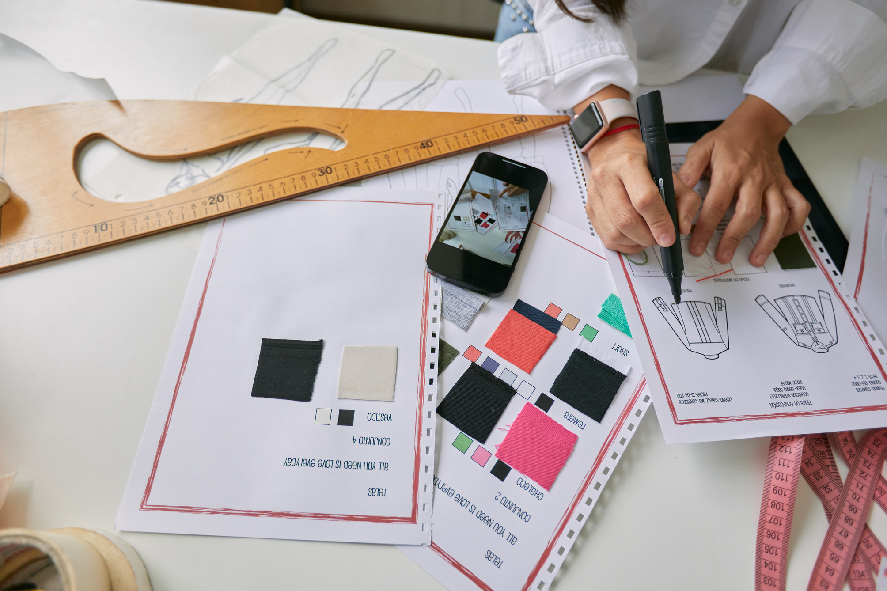
Portofolio
Portofolios are used to document work that has been done
Need it for:
Graphic Design, UIUX, Digital Marketing, Programming, Photographer

Slide 12
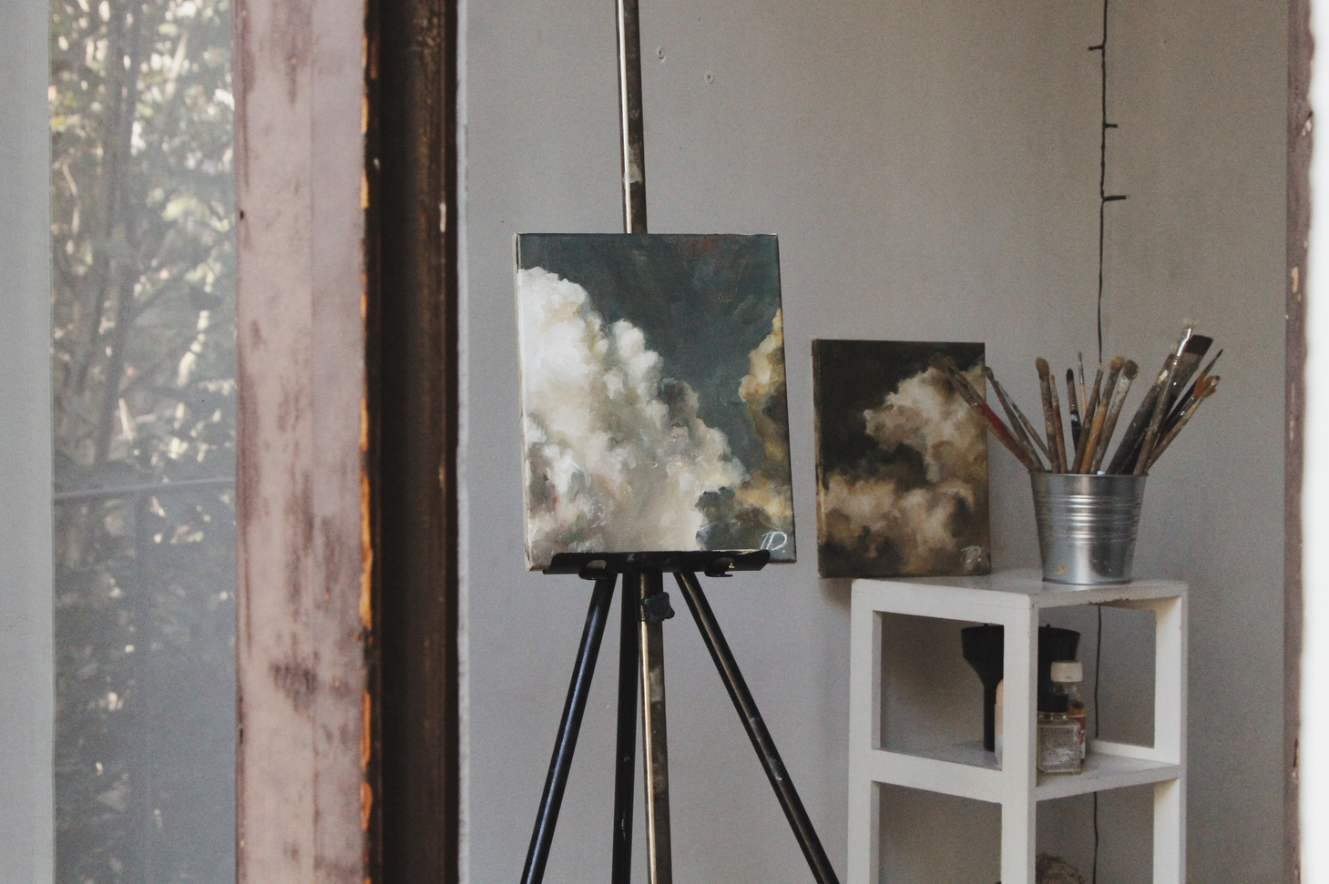
Portofolio
Content:
Identity (Name)
Educational background
Work experience (describe it)
Mastered application
Masterpieces

Slide 13
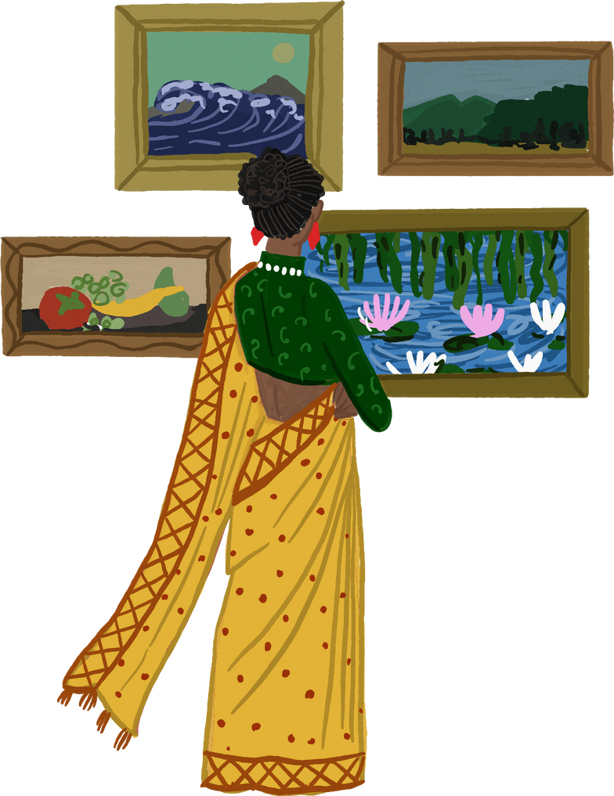
Portofolio
Masterpieces:
your own work
relevant for the position you applying for
recent – oldest works
choose the best
year of work (2022)
explanation: detail (essence)

Slide 14



Portofolio
Form:
magazines
brochures
Paper used:
cartoon
ivory
Common size:
8.5 inches x 11 inches
11 inches x 14 inches
14 inches x 17 inches

Slide 15


E-Mail:
magangjogja.com

